Slide 1
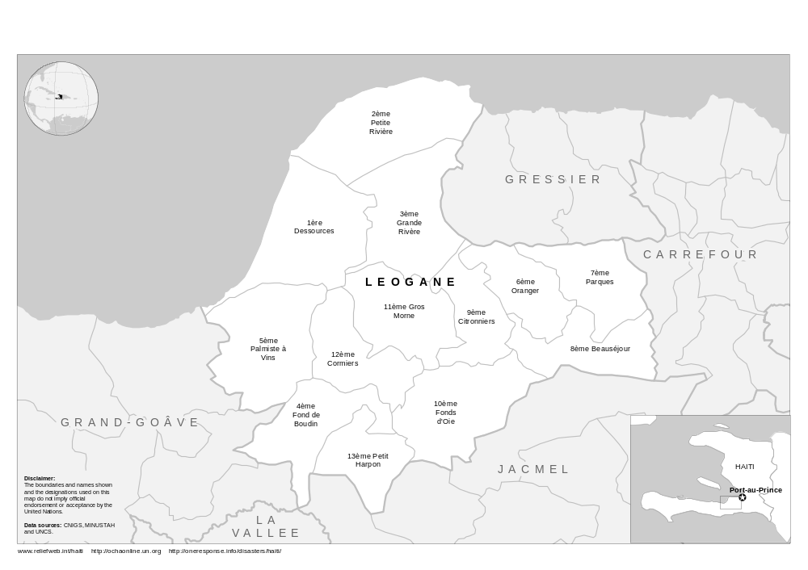








HAITI – Ouest – Leogane: Relief Assistance Presence (as of 31 Jan 2010)
Number of organizations
Early Recovery/Agriculture: 2 organizations
Education: 0
Food: 6
Health: 18
Protection: 2
Shelter and Non-Food Items: 9
Water and Sanitation: 13

Slide 2
HAITI – Ouest – Leogane: Early Recovery/Agriculture Cluster Presence (as of 31 Jan 2010)
Total: 2 organizations
UNDP, WHH

Slide 3
HAITI – Ouest – Leogane: Education Cluster Presence (as of 31 Jan 2010)
Total: 0 organizations

Slide 4
HAITI – Ouest – Leogane: Food Cluster Presence (as of 31 Jan 2010)
Total: 6 organizations
ACTED, Caritas, WFP, Samaritan's Purse, Save the Children, GTZ

Slide 5
HAITI – Ouest – Leogane: Health Cluster Presence (as of 31 Jan 2010)
Total: 18 organizations
MSF
MSF
Argentinean White Helmets, CMAT, Canadian Forces, Cubans, Japanese Forces, Malteser, MSF, MDM, Pompiers Sans Frontieres, World Wide Village, Americare, Save the Children, Samaritan Austria, Heart to Heart, Help, Hands On Disaster Response, Children's Nutrition Program of Haiti, Medical Benevolence Foundation

Slide 6
HAITI – Ouest – Leogane: Protection Cluster Presence (as of 31 Jan 2010)
Total: 2 organizations
Terre des Hommes, Save the Children

Slide 7
HAITI – Ouest – Leogane: Shelter and Non-Food Items Cluster Presence (as of 31 Jan 2010)
Total: 9 organizations
ACTED, CARE, INTERSOS, Samaritan's Purse, MSF, WHH, GTZ, French RC, Finish RC

Slide 8
HAITI – Ouest – Leogane: Water and Sanitation Cluster Presence (as of 31 Jan 2010)
Total: 13 organizations
ACH, ACTED, CARE, IOM, Malteser, Spanish Red Cross, Austrian Red Cross, MSF, Arche Nova, Save the Children, Norwegian Church Aid, Haiti Outreach, INTERSOS

Slide 9





Symbology
Agriculture
Camp Coordination/Management
Coordination
Early Recovery
Education
Emergency Telecommunications
Food
Health
Logistics
Protection
Shelter and Non-Food Items
Water and Sanitation

